Slide 1
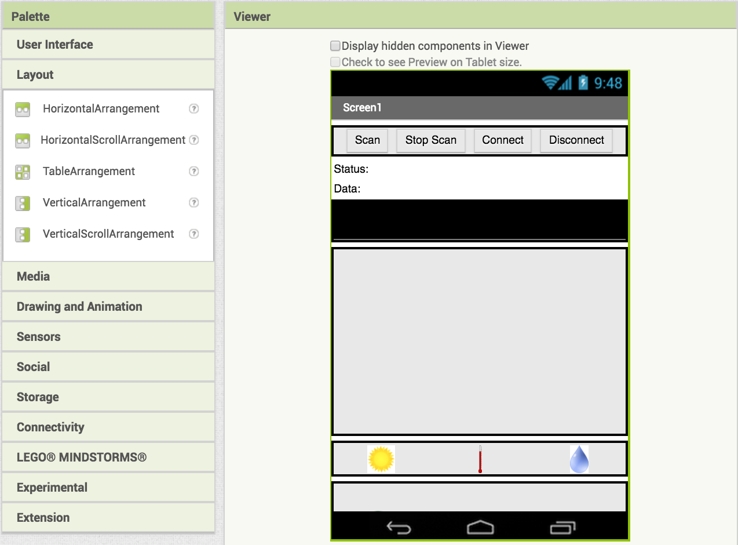
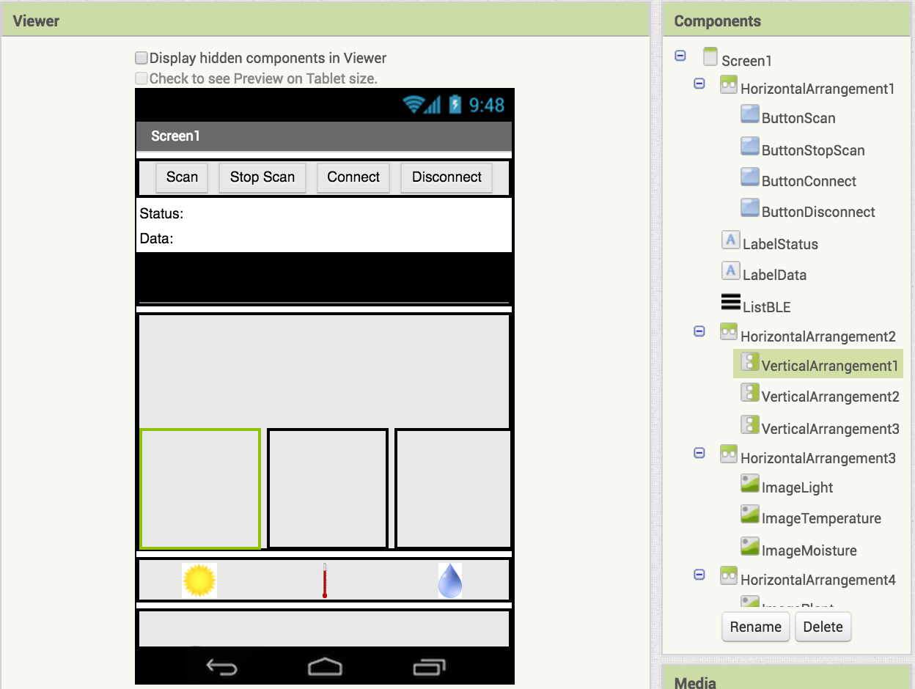
CIS Healthy Plant Monitoring App: Adding Graphs
Add 3 VerticalArrangements inside the HorizontalArrangement
3x
Your screen should now look like this

Slide 2
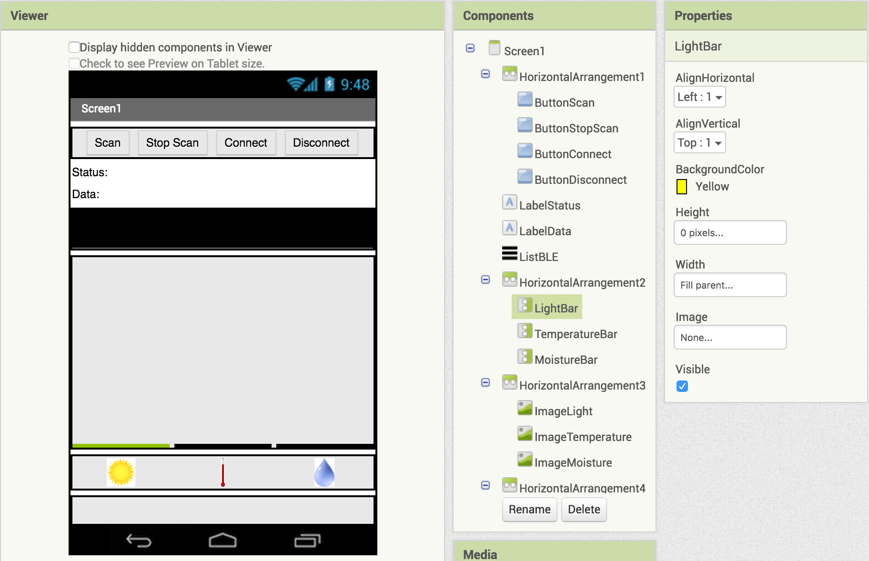
Rename them LightBar, TemperatureBar, MoistureBar

Slide 3

Set each bar's height to 0px and width to Fill Parent
Now set LightBar BackgroundColor to Yellow, TemperatureBar BackgroundColor to Red, and MoistureBar BackgroundColor to Blue
The boxes should now look flat

Slide 4

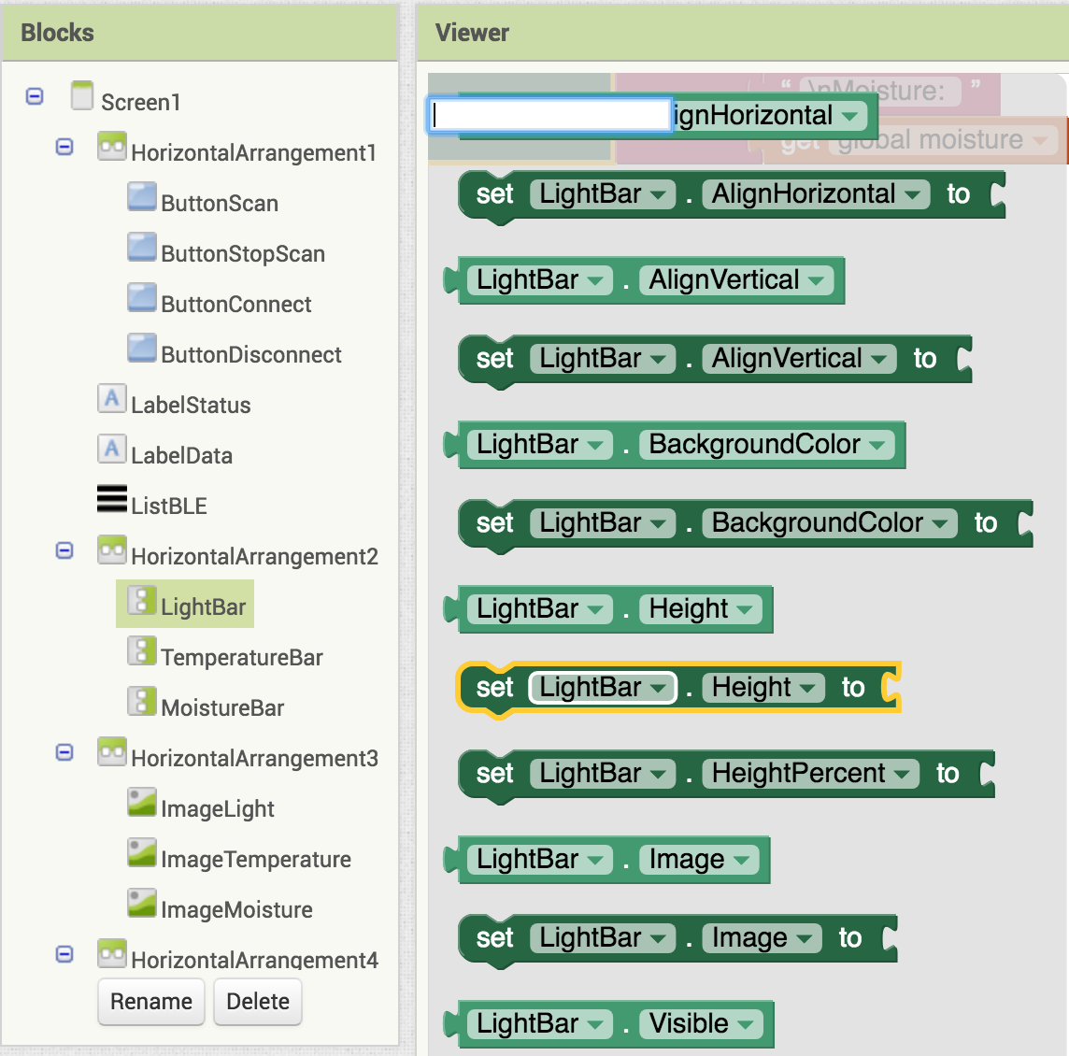


Switch to the Blocks Editor view
Now we will change the sizes of the graphs based on the readings we get
Drag in
Find
and connect them together

Slide 5
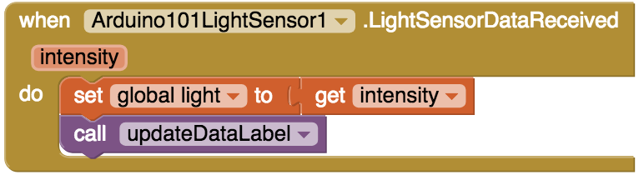
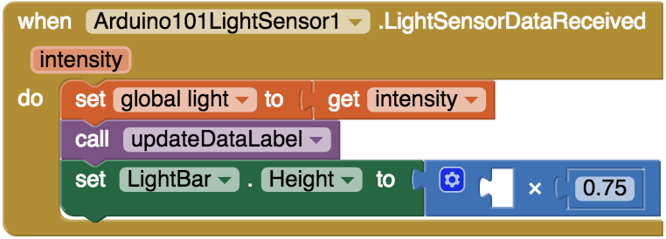
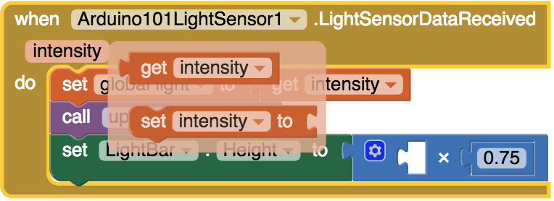
Find
Add your other blocks
Hover your mouse over the word "intensity"
A popup should appear

Slide 6

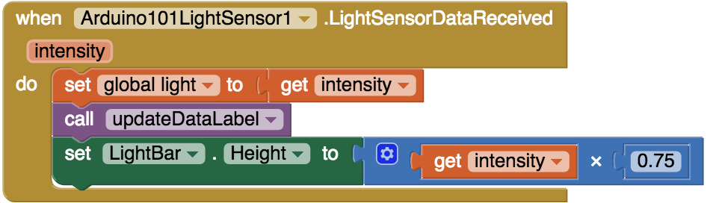
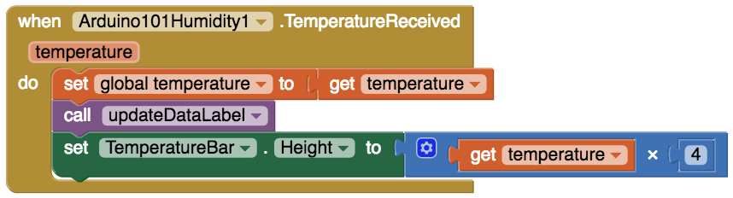
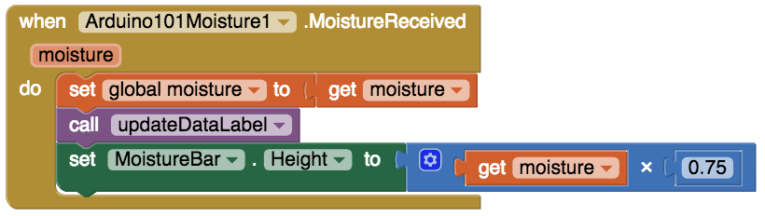
Drag
into the open part of your code
(this gets the light reading from the sensor)
Do the same thing for MoistureBar and TemperatureBar. They should look like this when you are done
Now try out your app and see what happens to the bars!

Slide 7
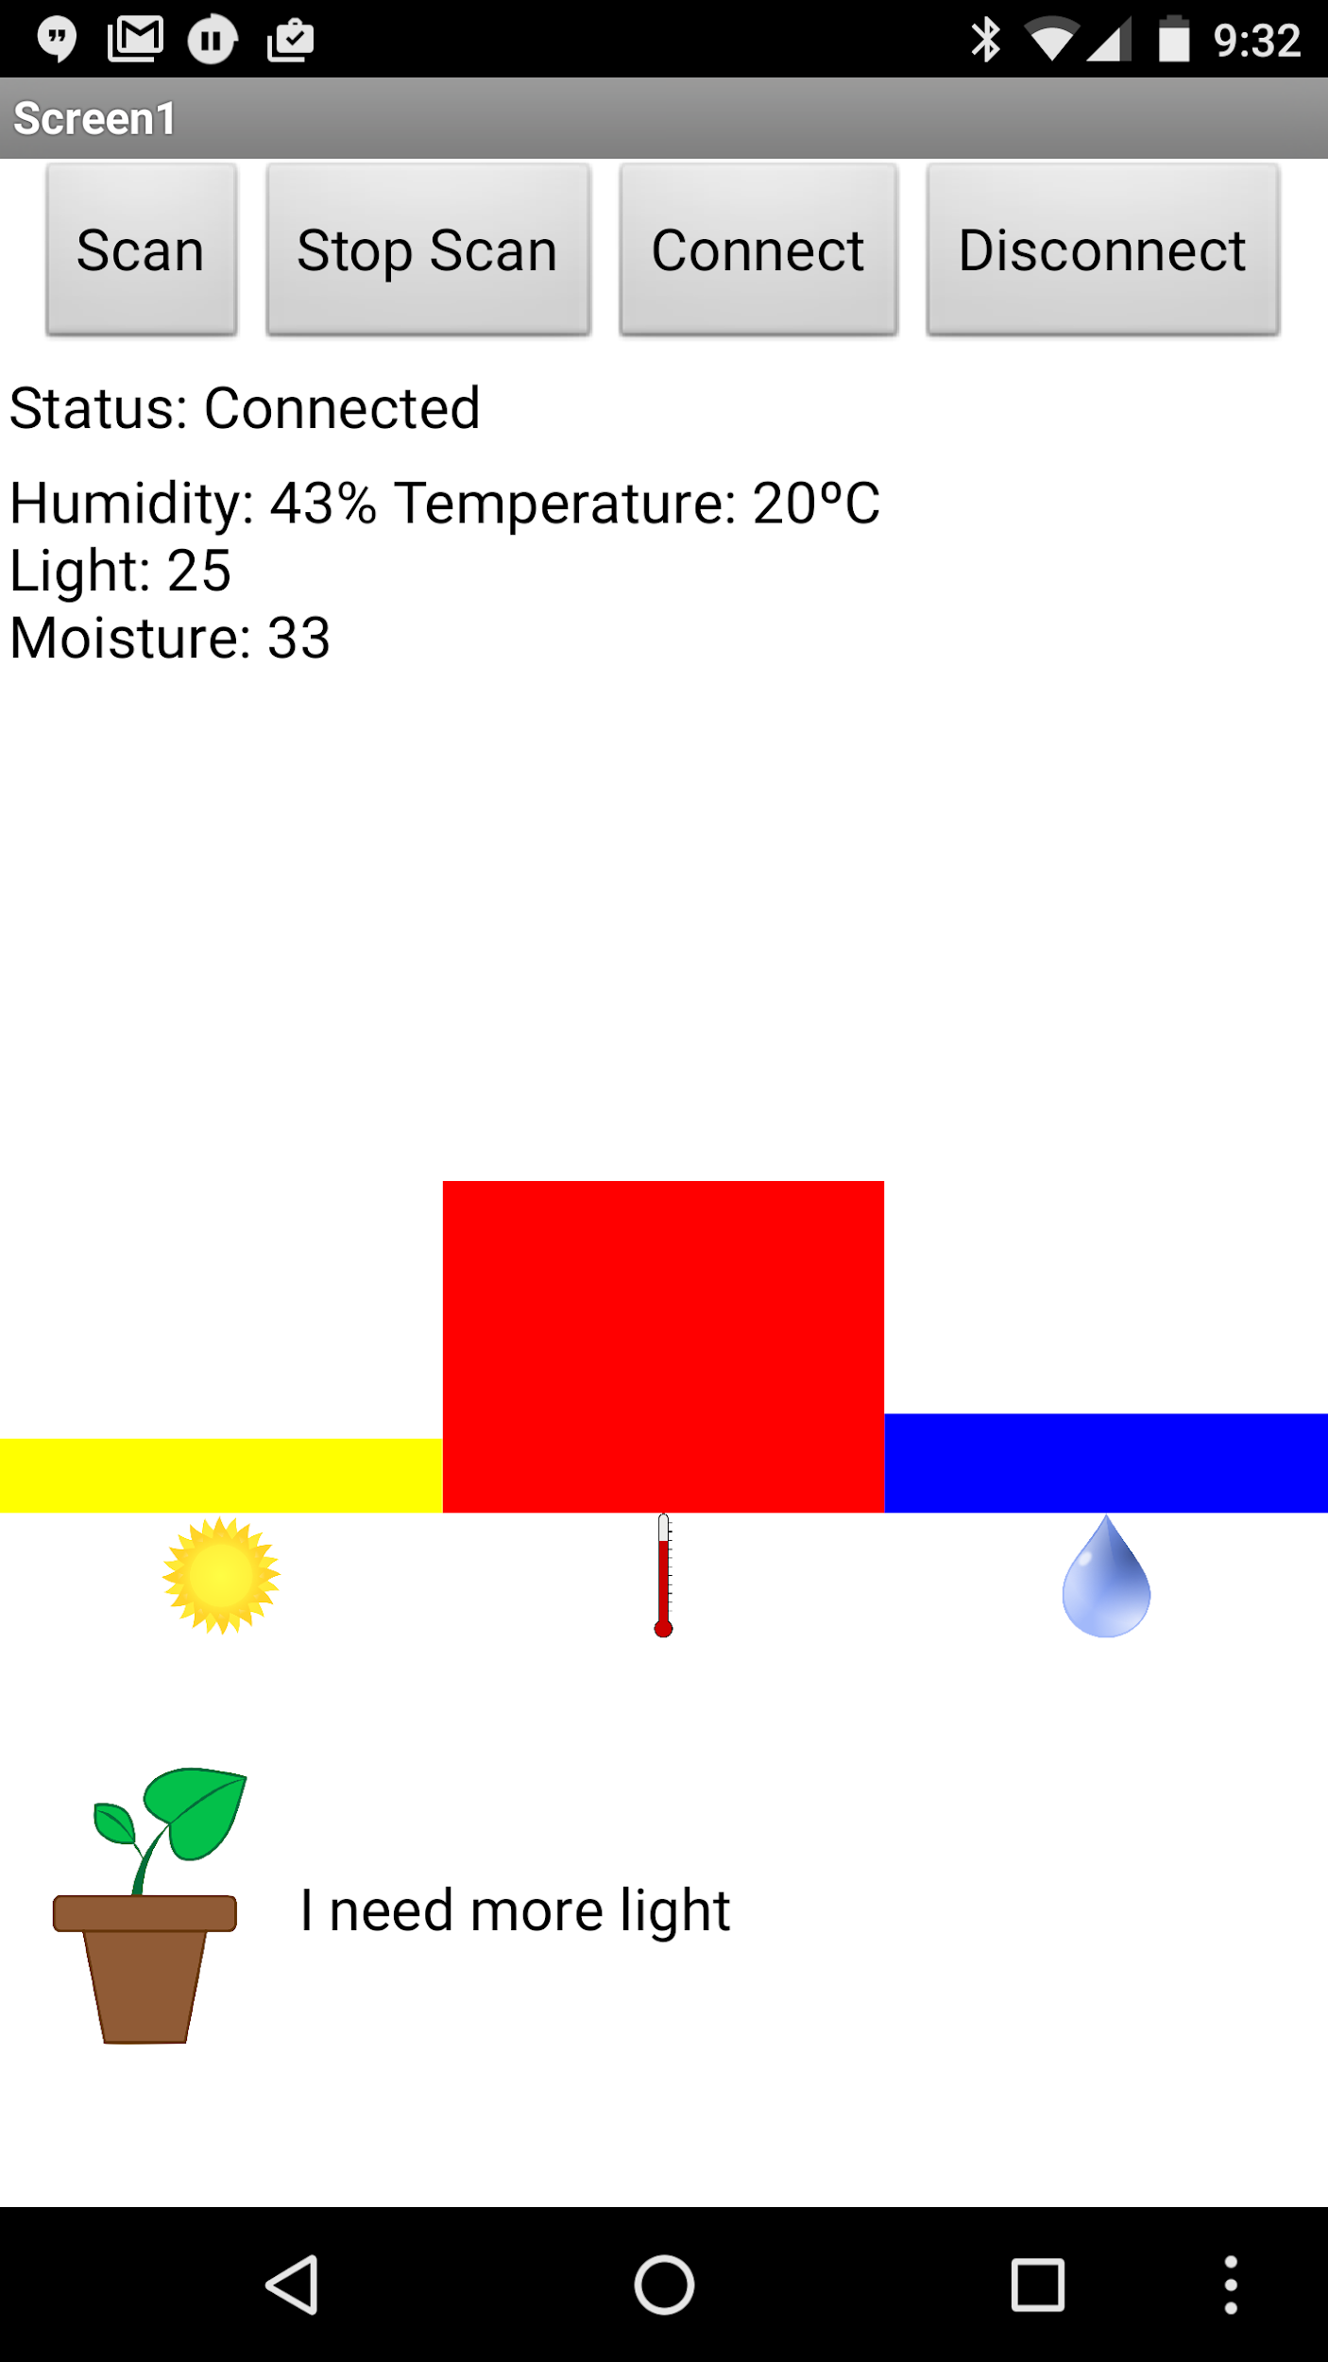
Your final app should look something like this:

